Slide 1

Coding Exercise
By Min Thet Naing

Slide 2
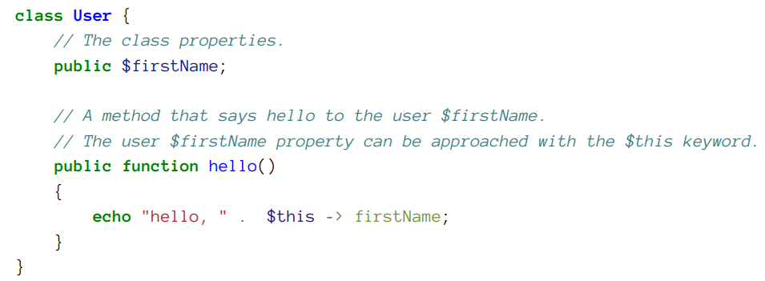
By Min Thet Naing

Slide 3
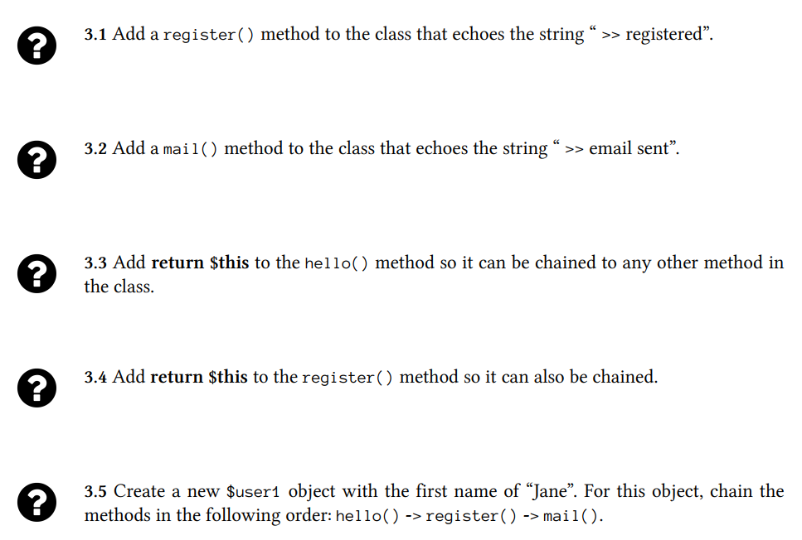
By Min Thet Naing

Slide 4

Expected Result
By Min Thet Naing

